Slide 1
Chapter 2 Signals and Spectra

Slide 2
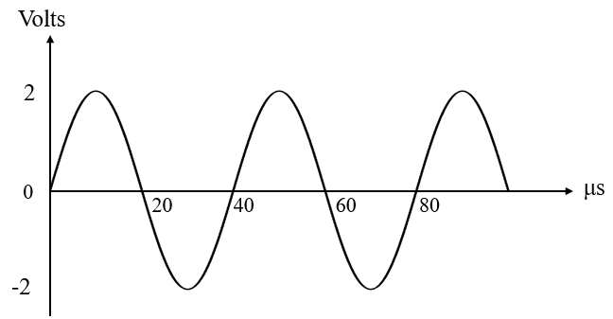
Tutorial 2
3. (a) What is the DC level of the signal in Figure T2.3?
(b) Sketch the double-sided amplitude spectrum for the sinusoidal waveform in Figure T2.3.
Guided Solution
(a)
Determine if the signal contains DC voltage.
(b)
Determine if it is periodic or non-periodic.
If it is periodic, find the period.
Calculate the fundamental frequency.
Determine how many frequency components the signal contains.
Find the amplitude of the frequency component(s).
6. Convert single-sided amplitude to double-sided amplitude.
Plot the amplitude vs frequency for each frequency component
for both positive and negative frequencies.
Figure T2.3 A sinusoidal waveform

Slide 3
4. Sketch the double-sided spectrum of an AM signal, v_{AM}(t) whose carrier v_{C}(t) = V_{C}cosω_{C}t is modulated by the modulating signal, v_{S}(t).
v_{S}(t) = V₁cosω₁t + V₂cosω₂t + V₃cosω₃t where V₁ > V₂ > V₃ and f₃ > f₂ > f₁
Guided Solution
1. Find the frequency and amplitude of each frequency component of the signal.
2. Represent each frequency component by a spectrum line to obtain the single-sided amplitude spectrum.
3. Covert the single-sided amplitude spectrum to double-sided amplitude spectrum.

Slide 4
Tutorial 2
5. The Trigonometric Fourier series of a waveform which repeats itself every 125 μs is given by
v(t) = 0.4 + 0.8sin0.2π cosω₀t + 0.8sin0.4π cos2ω₀t
0.2π 0.4π
+ 0.8sin0.6π cos3ω₀t + 0.8sin0.8π cos4ω₀t + . . .
0.6π 0.8π
Sketch the single-sided and double-sided amplitude spectrum of the signal up to the 4th harmonic, showing the amplitude and frequency of each component.
Guided Solution
Determine if it is periodic or non-periodic.
2. Identify the DC component, fundamental and harmonic frequency components.
Calculate the fundamental frequency.
Determine the harmonic frequencies.
Find the amplitude of each frequency component.
Convert single-sided amplitude to double-sided amplitude.
7. Plot the amplitude vs frequency for each frequency component for both positive and negative frequencies.

Slide 5
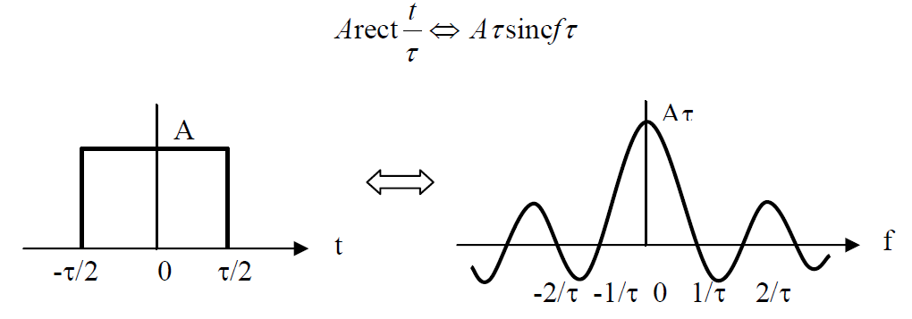
Tutorial 2
6. Sketch the amplitude spectrum of rect (t).
Guided Solution
Find the width and height of the rectangular pulse.
Determine if it is periodic or non-periodic?
Determine if it has discrete or continues spectrum.
Identify the shape of the spectrum.
Plot the spectrum and label the frequencies and the DC level.
Plot the amplitude spectrum.

Slide 6
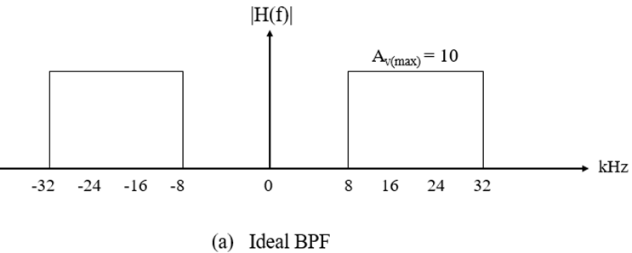
9. (a) The signal in question 5 is input to the ideal BPF shown in Figure T2.9 (a).
Draw the double-sided amplitude spectrum of the filter output signal.
Tutorial 2
v(t) = 0.4 + 0.8sin0.2π cosω₀t + 0.8sin0.4π cos2ω₀t
0.2π 0.4π
+ 0.8sin0.6π cos3ω₀t + 0.8sin0.8π cos4ω₀t + . . .
0.6π 0.8π
Guided Solution
(a)
Find the gain of the BPF.
Find the cut-off frequencies.
Determine the passband of the BPF.
Determine the frequency components present at the output of the BPF.
6. Apply the gain on those frequency components.
7. Plot the resultant double-sided amplitude vs frequency for those frequency component.

Slide 7
Tutorial 2
9. (b) The same signal is input to the practical BPF shown in Figure T2.9 (b).
The BPF has a passband from 8 kHz to 32 kHz. Draw the amplitude spectrum
of the filter output signal.
|H(f)|
A_{V(max)} = 10
kHz
-32
-24
-16
-8
0
8
16
24
32
Guided Solution
(b)
Find the gain of the BPF.
Find the gain at 3dB cut-off frequency.
Determine the lower and upper 3 dB cut-off frequencies.
Determine the passband of the BPF.
Determine the frequency components present at the output of the BPF.
6. Apply the gain on those frequency components.
7. Plot the resultant double-sided amplitude vs frequency for those frequency component.

